Slide 1


Module 3: Bayesian Classification and Regression
6040 Bayesian Machine Learning
Prof. Bill Basener

Slide 2

Where you should be in this course:
Learning Progress:
Watching all Videos in Collab
Reading Text for each Module
YouTube videos from M1 on Bayesian Statistics (Bayes Them, Priors, etc.)
* I.O.U. a video on conjugate priors.
Homework:
Working on HW1
Required Assignment in M3.5 (has code + video)

Slide 3
Topics:
Theory – Statistical Decision Theory, Likelihoods, and Bayes ML.
Bayesian Framework for Linear Regression.
Regularization and ridge regression.
Bayesian Framework for classification assuming Gaussian distributions.
LDA and QDA with probabilities for classification and use of priors.
General Principles:
Bayesian methods provide probabilities for parameters & predictions.
Priors act as buffer against overtraining in Bayesian Regression.
As data is larger, priors become less significant/impactful/important.
Chapter 1

Slide 4
Priors:

Slide 5
From video lecture notes:
General idea of computing priors

Slide 6
Bayes Theorem:
$$P\left(θ_{i}|X\right)=\frac{P(X|θ_{i})P\left(θ_{i}\right)}{\sum_{k}{P(X|θ_{k})P\left(θ_{k}\right)}}$$
The extreme noninformative prior
Flat Prior: $P\left(θ_{k}\right)=c$ (a constant)
$$P\left(θ_{i}|X\right)=\frac{P\left(X | θ_{i}\right)c}{\sum_{k}{P\left(X | θ_{k}\right)c}}=\frac{P\left(X | θ_{i}\right)}{\sum_{k}{P\left(X | θ_{k}\right)}}$$
Priors – Noninformative/Uninformative/Constant Prior
Chapter 1

Slide 7
Bayes Theorem:
$$P\left(θ_{i}|X\right)=\frac{P(X|θ_{i})P\left(θ_{i}\right)}{\sum_{k}{P(X|θ_{k})P\left(θ_{k}\right)}}$$
The extreme noninformative prior
Flat Prior: $P\left(θ_{k}\right)=c$ (a constant)
$$P\left(θ_{i}|X\right)=\frac{P\left(X | θ_{i}\right)c}{\sum_{k}{P\left(X | θ_{k}\right)c}}=\frac{P\left(X | θ_{i}\right)}{\sum_{k}{P\left(X | θ_{k}\right)}}$$
Priors – Noninformative/Uninformative/Constant Prior
Chapter 1

Slide 8
Bayes Theorem:
$$P\left(θ_{i}|X\right)=\frac{P(X|θ_{i})P\left(θ_{i}\right)}{\sum_{k}{P(X|θ_{k})P\left(θ_{k}\right)}}$$
The extreme noninformative prior
Flat Prior: $P\left(θ_{k}\right)=c$ (a constant)
$$P\left(θ_{i}|X\right)=\frac{P\left(X | θ_{i}\right)c}{\sum_{k}{P\left(X | θ_{k}\right)c}}=\frac{P\left(X | θ_{i}\right)}{\sum_{k}{P\left(X | θ_{k}\right)}}$$
Priors
Priors – Noninformative/Uninformative/Constant Prior
Chapter 1

Slide 9
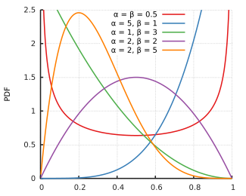
Binomial and Beta Distributions
Binomial: Distribution for k = the number of success (“heads”) out of n Bernoulli trials each with probability p of success:
$$f\left(k|n,p\right)=\left(\begin{matrix}n \\ k\end{matrix}\right)p^{k}{(1−p)}^{n−k}$$
Beta: Distribution:
$$g\left(p|α,β\right)=\frac{1}{B(α,β)}p^{α−1}{(1−p)}^{β−1}$$
NOTE: $E\left[p\right]=\frac{α}{α+β}$
Priors – Beta Binomial

Slide 10
$$E\left[p\right]=\frac{α}{α+β}$$
Like $α$ succeses
In $α+β$ trials.
Priors – Beta Binomial

Slide 11
Binomial and Beta Distributions
Binomial: $f\left(k|n,p\right)=\left(\begin{matrix}n \\ k\end{matrix}\right)p^{k}{(1−p)}^{n−k}$
Beta: $g\left(p|α,β\right)=\frac{1}{B(α,β)}p^{α−1}{(1−p)}^{β−1}$
$$P\left(θ | X\right)=\frac{P\left(X | θ\right)P(θ)}{\int{P\left(X | θ\right)P\left(θ\right)dθ}}$$
$$\int_{0}^{1}{p^{α−1}{(1−p)}^{β−1}}dp$$
THEOREM: If the likelihood function is a binomial distribution on k with parameters {n, p} and the prior on p (assuming n is fixed) is a beta distribution with parameters {$α,β$}, then the posterior probability distribution is a beta distribution:
$P\left(p | n,k\right) =\text{Beta}(k+α$, $n−k+β$)
Priors – Beta Binomial

Slide 12
Binomial and Beta Distributions
Binomial: $f\left(k|n,p\right)=\left(\begin{matrix}n \\ k\end{matrix}\right)p^{k}{(1−p)}^{n−k}$
Beta: $g\left(p|α,β\right)=\frac{1}{B(α,β)}p^{α−1}{(1−p)}^{β−1}$
$$P\left(θ | X\right)=\frac{P\left(X | θ\right)P(θ)}{\int{P\left(X | θ\right)P\left(θ\right)dθ}}$$
$$\int_{0}^{1}{p^{α−1}{(1−p)}^{β−1}}dp$$
$$=\frac{\left[\left(\begin{matrix}n \\ k\end{matrix}\right)p^{k}{(1−p)}^{n−k}\right]\left[\frac{1}{B(α,β)}p^{α−1}{(1−p)}^{β−1}\right]}{\int_{0}^{1}{\left[\left(\begin{matrix}n \\ k\end{matrix}\right)p^{k}{(1−p)}^{n−k}\right]\left[\frac{1}{B(α,β)}p^{α−1}{(1−p)}^{β−1}\right]}dp}$$
$$=\frac{p^{k+α−1}{(1−p)}^{n−k+β−1}}{\int_{0}^{1}{p^{k+α−1}{(1−p)}^{n−k+β−1}}dp}$$
$$=\frac{1}{B(k+α,n−k+β)}p^{k+α−1}{(1−p)}^{n−k+β−1}$$
$=\text{Beta}(k+α$, $n−k+β$)
Priors – Beta Binomial

Slide 13
THEOREM: If the likelihood function is a binomial distribution on k with parameters {n, p} and the prior on p (assuming n is fixed) is a beta distribution with parameters {$α,β$}, then the posterior probability distribution is a beta distribution:
$P\left(p | n,k\right) =\text{Beta}(k+α$, $n−k+β$)
A typical 47-year-old man can successfully kick a field goal 10% of attempts. ($α$=1, $β$=9, so $E\left[X\right]=\frac{α}{α+β}=0.1)$
I tried to kick a field goal 12 times and was successful on 3 attempts.
What is a probability distribution for p = the probability that I will be successful in an attempted kick?
Priors – Beta Binomial

Slide 14
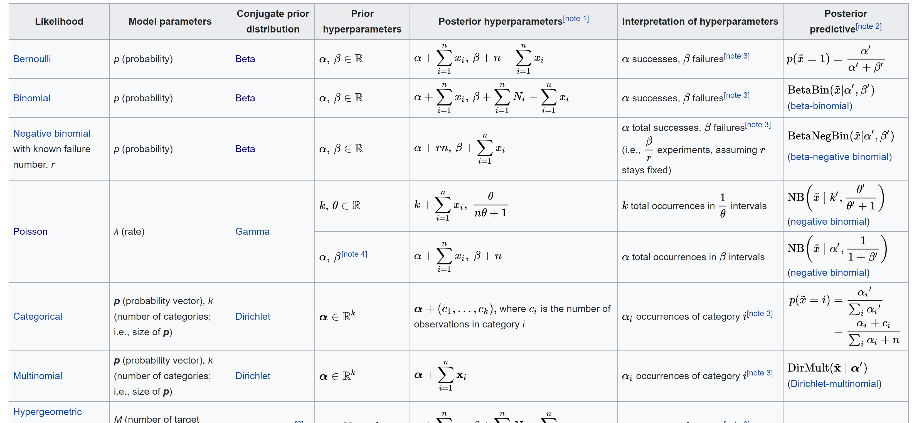
https://en.wikipedia.org/wiki/Conjugate_prior
Wikipedia

Slide 15
Decision Theory:

Slide 16


Statistical Decision Theory:
Prediction problem:
$X$ = input variable, $Y$ = output variable
GOAL: Find function $f$ (in some class of functions) so that
$y≈f(x)$ approximates the relationship
Loss function: $L(Y, f(X))$
[generalization of SSE: $L\left(Y, f\left(X\right)\right)=\sum_{i}{{\left(y_{i}−f(x_{i})\right)}^{2} ]}$

Slide 17
Statistical Decision Theory:
Loss (aka Cost) Function:
Y=Actual Plant Type
 | Delectable Tea Plant | Deadly Poison Plant
Make Tea | C11 | C12
Do Not Touch | C21 | C22
Assume Posterior Probabilities:
P(Tea) = 0.8
P(Poison) = 0.2
f(X)=Decision
E[C|Make Tea] = P(Tea)C11+ P(Poison)C12
E[C|Do Not Touch] = P(Tea)C21+ P(Poison)C22

Slide 18

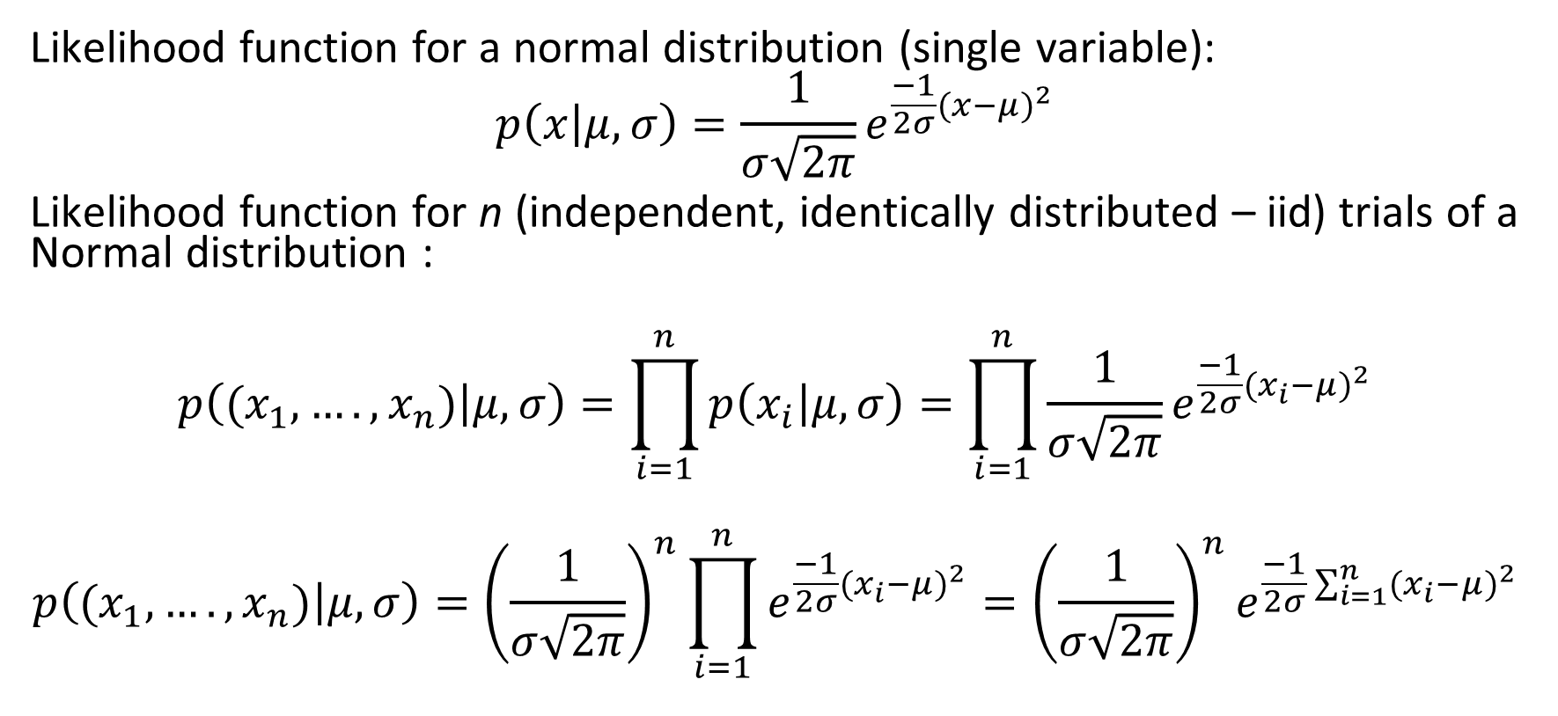
Likelihood for n Trials from Normal Distribution:
Likelihood function for a normal distribution (single variable):
$$p\left(x | μ,σ\right)=\frac{1}{σ\sqrt{2π}}e^{\frac{−1}{2σ}{(x−μ)}^{2}}$$
Likelihood function for n (independent, identically distributed – iid) trials of a Normal distribution :
$$p\left((x_{1},….,x_{n}) | μ,σ\right)=\prod_{i=1}^{n}{p\left(x_{i} | μ,σ\right)}=\prod_{i=1}^{n}{\frac{1}{σ\sqrt{2π}}e^{\frac{−1}{2σ}{(x_{i}−μ)}^{2}}}$$
$$p\left((x_{1},….,x_{n}) | μ,σ\right)={\left(\frac{1}{σ\sqrt{2π}}\right)}^{n}\prod_{i=1}^{n}{e^{\frac{−1}{2σ}{(x_{i}−μ)}^{2}}}={\left(\frac{1}{σ\sqrt{2π}}\right)}^{n}e^{\frac{−1}{2σ}\sum_{i=1}^{n}{{(x_{i}−μ)}^{2}}}$$
$p\left(A,B\right)=p\left(A\right)p\left(B\right)$ if A and B are independent
$$e^{a}e^{b}=e^{a+b}$$

Slide 19
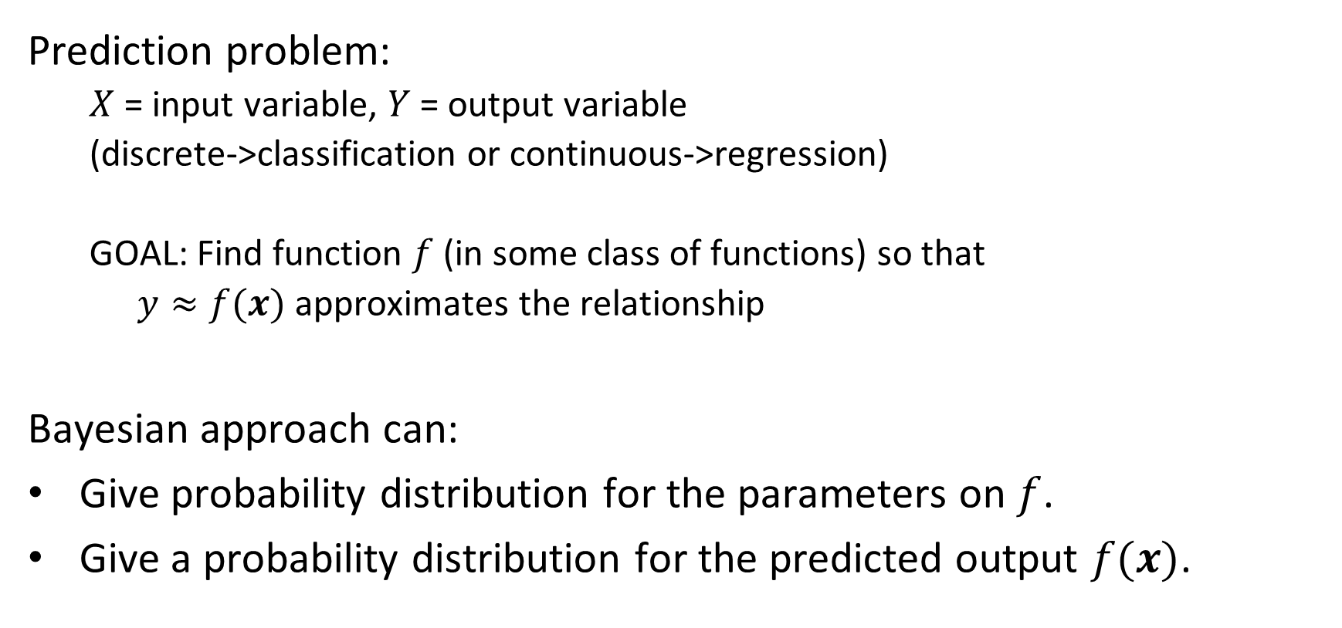
Bayesian Classification and Regression:
Prediction problem:
$X$ = input variable, $Y$ = output variable
(discrete->classification or continuous->regression)
GOAL: Find function $f$ (in some class of functions) so that
$y≈f(x)$ approximates the relationship
Bayesian approach can:
Give probability distribution for the parameters on $f$.
Give a probability distribution for the predicted output $f(x)$.

Slide 20
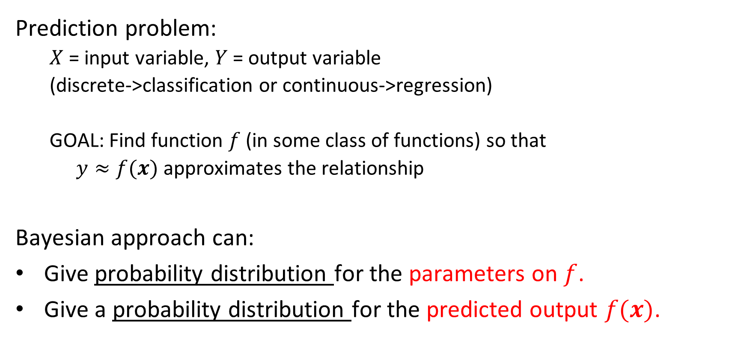
Bayesian Classification and Regression:
Prediction problem:
$X$ = input variable, $Y$ = output variable
(discrete->classification or continuous->regression)
GOAL: Find function $f$ (in some class of functions) so that
$y≈f(x)$ approximates the relationship
Bayesian approach can:
Give probability distribution for the parameters on $f$.
Give a probability distribution for the predicted output $f(x)$.

Slide 21

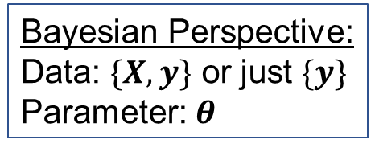
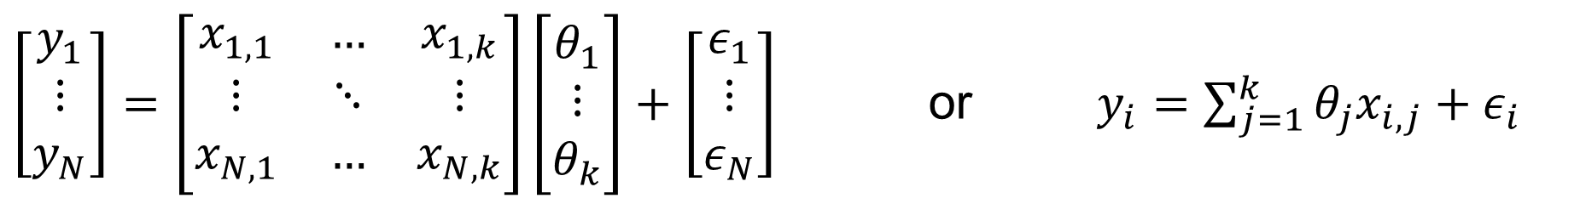
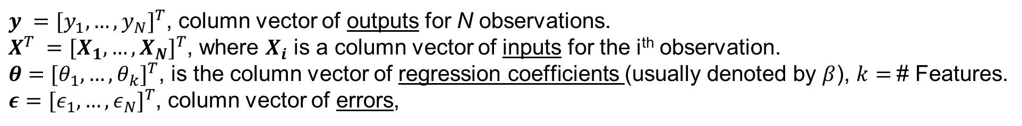
Ordinary Least Squares (OLS) Linear Regression:
Bayesian Perspective:
Data: $\{X,y\}$ or just $\{y\}$
Parameter: $θ$
$y ={[y_{1},…,y_{N}]}^{T}$, column vector of outputs for N observations.
$X^{T} ={[X_{1},…,X_{N}]}^{T}$, where $X_{i}$ is a column vector of inputs for the i^{th} observation.
$θ$ $={[θ_{1},…,θ_{k}]}^{T}$, is the column vector of regression coefficients (usually denoted by $β$), $k=$# Features.
$ε={[ε_{1},…,ε_{N}]}^{T}$, column vector of errors,
$\left[\begin{matrix}y_{1} \\ ⋮ \\ y_{N}\end{matrix}\right]=\left[\begin{matrix}x_{1,1} & … & x_{1,k} \\ ⋮ & ⋱ & ⋮ \\ x_{N,1} & … & x_{N,k}\end{matrix}\right]\left[\begin{matrix}θ_{1} \\ ⋮ \\ θ_{k}\end{matrix}\right]+\left[\begin{matrix}ε_{1} \\ ⋮ \\ ε_{N}\end{matrix}\right]$ or $y_{i}=\sum_{j=1}^{k}{θ_{j}x_{i,j}}+ε_{i}$
$$\hat{y_{i}}$$

Slide 22
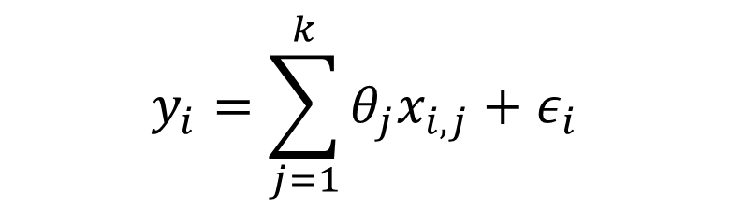
Ordinary Least Squares (OLS) Linear Regression:
$$y_{i}=\sum_{j=1}^{k}{θ_{j}x_{i,j}}+ε_{i}$$

Slide 23
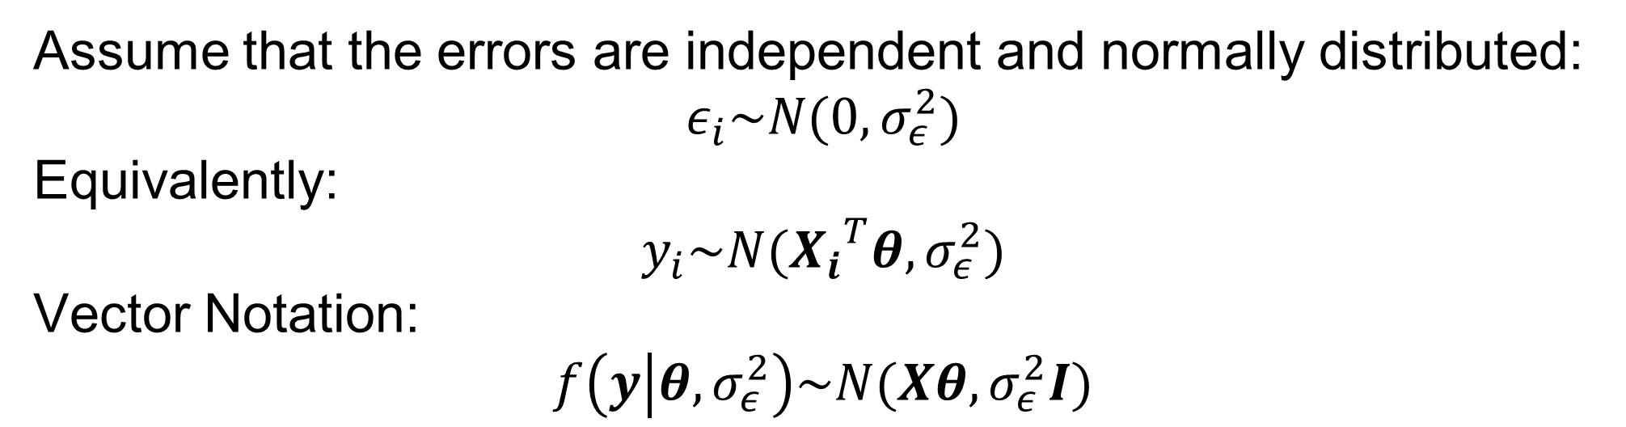
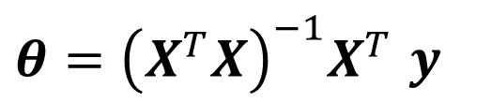

Ordinary Least Squares (OLS) Linear Regression:
Assume that the errors are independent and normally distributed:
$$ε_{i}\sim N(0,σ_{ε}^{2})$$
Equivalently:
$$y_{i}\sim N({X_{i}}^{T}θ,σ_{ε}^{2})$$
Vector Notation:
$$f\left(y | θ,σ_{ε}^{2}\right)\sim N(Xθ,σ_{ε}^{2}I)$$
Sum of Squares Error (SSE):
$$\left[\begin{matrix}ε_{1} & … & ε_{N}\end{matrix}\right] \left[\begin{matrix}ε_{1} \\ ⋮ \\ ε_{N}\end{matrix}\right]$$
$f\left(y | θ,σ_{ε}^{2}\right)\sim {\left(\frac{1}{σ_{ε}\sqrt{2π}}\right)}^{N}e^{\frac{−1}{2{σ_{ε}}^{2}}\sum_{i=1}^{N}{{(y_{i}−{X_{i}}^{T}θ)}^{2}}}$ ${=\left(\frac{1}{σ_{ε}\sqrt{2π}}\right)}^{N}e^{\frac{−1}{2{σ_{ε}}^{2}}{(y−Xθ)}^{T}(y−Xθ)}$
Solution: Find $θ$ that maximizes likelihood $f\left(y | θ,σ_{ε}^{2}\right)$, which occurs where $θ$ minimizes sum of squares error (SSE)
$θ={\left(X^{T}X\right)}^{−1}X^{T}$ $y$

Slide 24
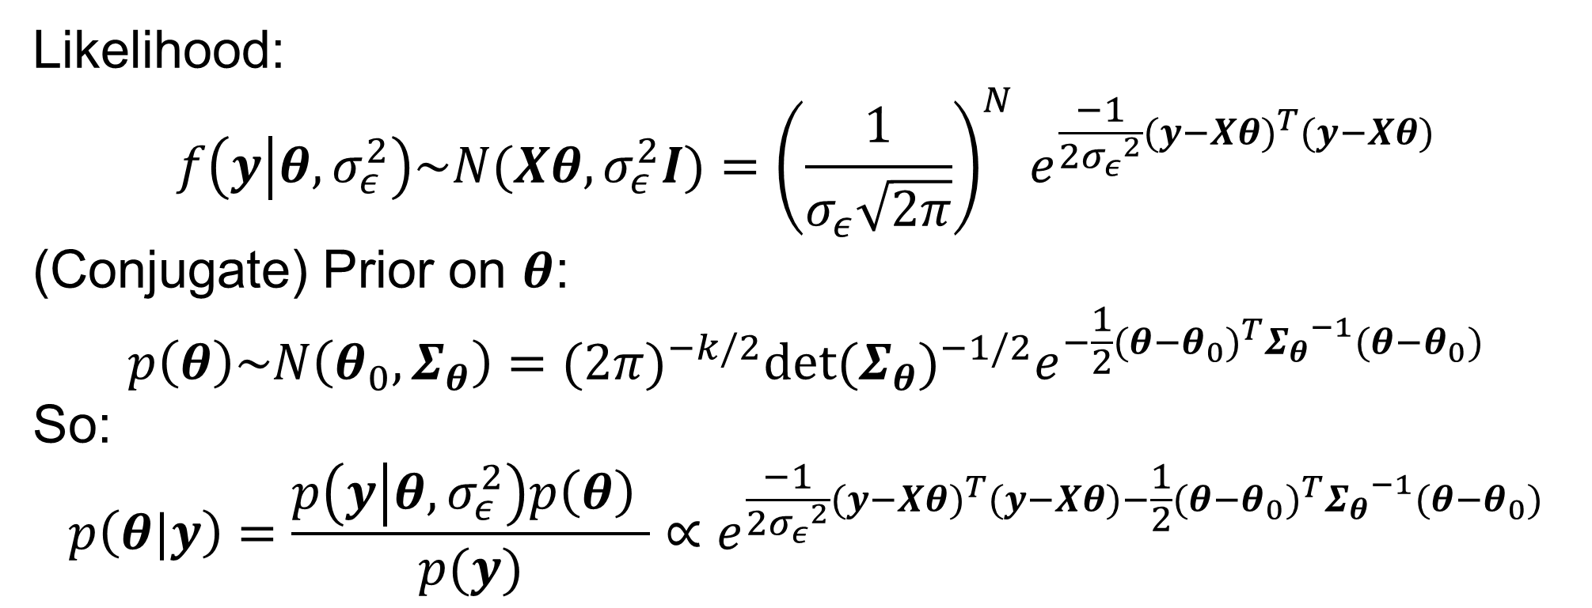
Bayesian OLS Linear Regression:
Likelihood:
$$f\left(y | θ,σ_{ε}^{2}\right)\sim N(Xθ,σ_{ε}^{2}I){=\left(\frac{1}{σ_{ε}\sqrt{2π}}\right)}^{N}e^{\frac{−1}{2{σ_{ε}}^{2}}{(y−Xθ)}^{T}(y−Xθ)}$$
(Conjugate) Prior on $θ$:
$$p\left(θ\right)\sim N\left(θ_{0},Σ_{θ}\right)={(2π)}^{−k/2}{det⁡(Σ_{θ})}^{−1/2}e^{−\frac{1}{2}{(θ−θ_{0})}^{T}{Σ_{θ}}^{−1}(θ−θ_{0})}$$
So:
$$p\left(θ|y\right)=\frac{p\left(y | θ,σ_{ε}^{2}\right)p\left(θ\right) }{p(y)}∝e^{\frac{−1}{2{σ_{ε}}^{2}}{(y−Xθ)}^{T}(y−Xθ)−\frac{1}{2}{(θ−θ_{0})}^{T}{Σ_{θ}}^{−1}(θ−θ_{0})}$$
[NOTE: This determines the mean in the distribution f via $Xθ$. We are assuming the variance $σ_{ε}^{2}I$ is known “known variance, unknown mean”.]

Slide 25
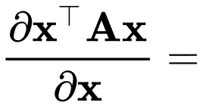

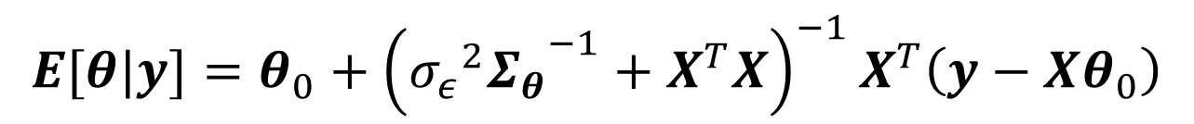


Bayesian OLS Linear Regression:
$$p\left(θ|y\right)=\frac{p\left(y | θ,σ_{ε}^{2}\right)p\left(θ\right) }{p(y)}∝e^{\frac{−1}{2{σ_{ε}}^{2}}{(y−Xθ)}^{T}(y−Xθ)−\frac{1}{2}{(θ−θ_{0})}^{T}{Σ_{θ}}^{−1}(θ−θ_{0})}$$
To find the Maximum A Posteriori (MAP) estimate for $θ$ we take the derivative and set to zero, then solve for $θ$:
$\frac{∂p\left(θ|y\right)}{∂θ}∝\frac{∂[\frac{−1}{2{σ_{ε}}^{2}}{\left(y−Xθ\right)}^{T}\left(y−Xθ\right)−\frac{1}{2}{\left(θ−θ_{0}\right)}^{T}{Σ_{θ}}^{−1}\left(θ−θ_{0}\right)]}{∂θ}=0$
$$θ=θ_{0}+{\left({σ_{ε}}^{2}{Σ_{θ}}^{−1}+X^{T}X\right)}^{−1}X^{T}\left(y−Xθ_{0}\right)$$
For details on this step, see:
https://en.wikipedia.org/wiki/Matrix_calculus
Showing identities such as:
$$E[θ|y]=θ_{0}+{\left({{{σ_{ε}}^{2}Σ}_{θ}}^{−1}+X^{T}X\right)}^{−1}X^{T}\left(y−Xθ_{0}\right)$$
Compare to OLS: $θ={\left(X^{T}X\right)}^{−1}X^{T}$ $y$

Slide 26
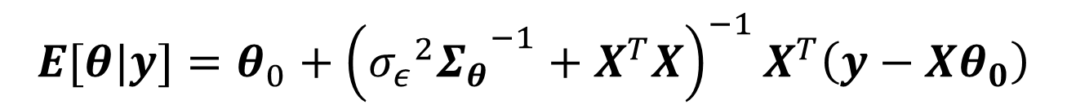
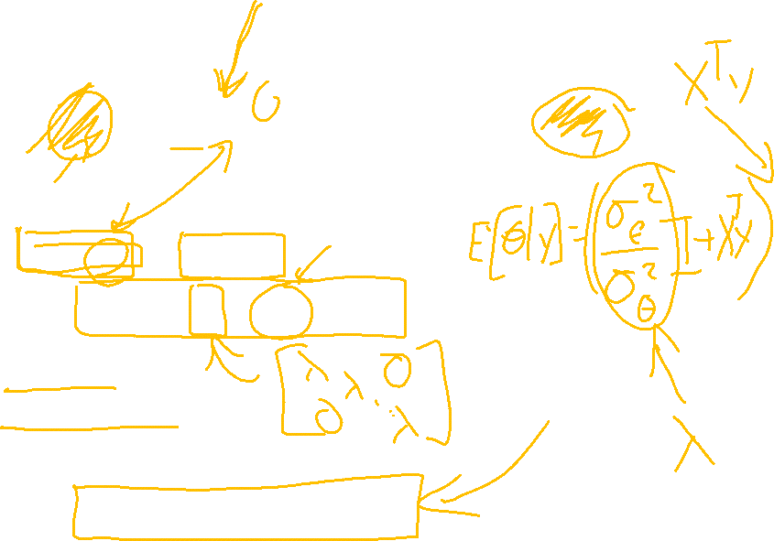
Bayesian OLS Linear Regression:
$${E[θ|y]=θ}_{0}+{\left({{σ_{ε}}^{2}Σ_{θ}}^{−1}+X^{T}X\right)}^{−1}X^{T}\left(y−Xθ_{0}\right)$$
Compare to OLS: $θ={\left(X^{T}X\right)}^{−1}X^{T}$ $y$

Slide 27
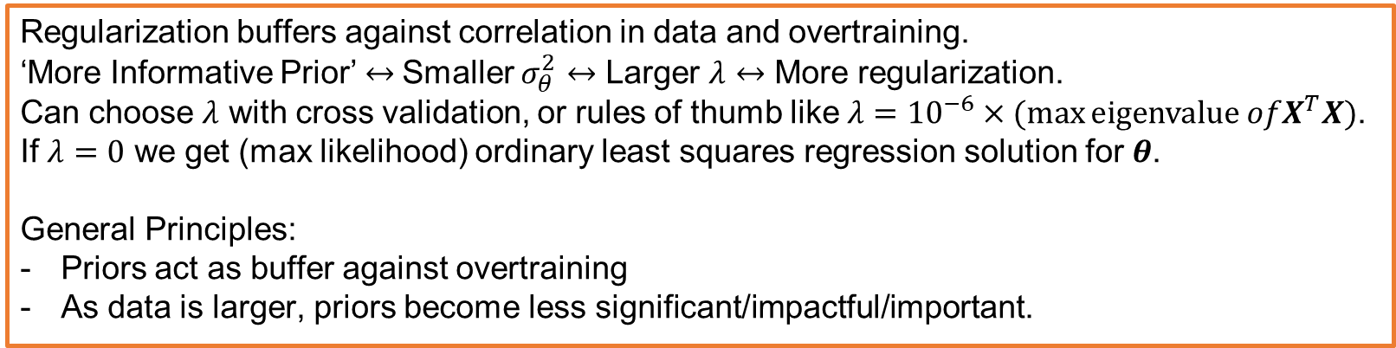
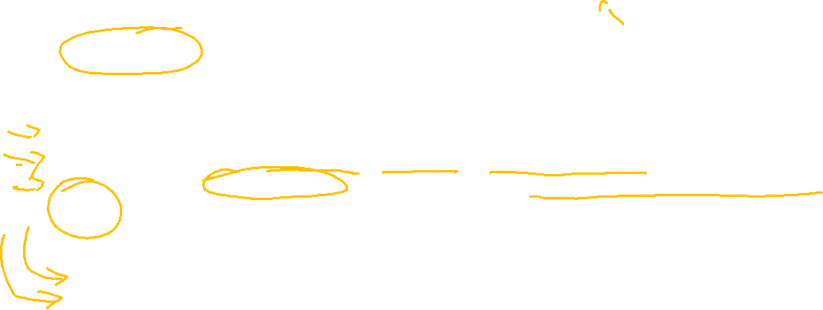
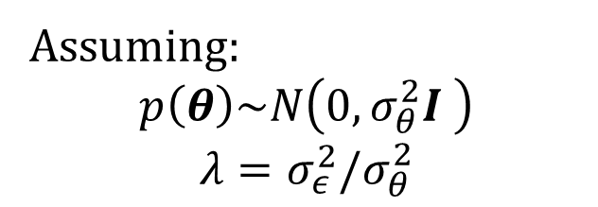
Bayesian OLS Linear Regression:
Assuming:
$$p\left(θ\right)\sim N\left(0,σ_{θ}^{2}I \right)$$
$$λ=σ_{ε}^{2}/σ_{θ}^{2}$$
$$θ_{Ridge}={\left(λI+X^{T}X\right)}^{−1}X^{T}y$$
Covariance Matrix
Regularization buffers against correlation in data and overtraining.
‘More Informative Prior’ $↔$Smaller $σ_{θ}^{2}$ $↔$ Larger $λ$ $↔$ More regularization.
Can choose $λ$ with cross validation, or rules of thumb like $λ={10}^{−6}×(max{\text{eigenvalue} ofX^{T}X)}$.
If $λ=0$ we get (max likelihood) ordinary least squares regression solution for $θ$.
General Principles:
Priors act as buffer against overtraining
As data is larger, priors become less significant/impactful/important.
Compare to OLS: $θ={\left(X^{T}X\right)}^{−1}X^{T}$ $y$

Slide 28
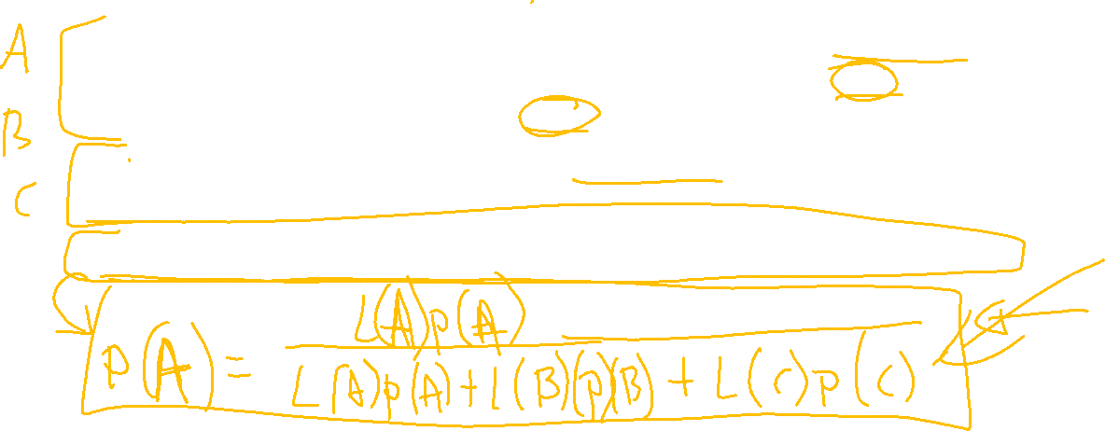
Bayesian Classification
Assume a distribution type for each class (typically, Gaussian either assuming all classes have the same covariance as in LDA or each with its own covariance as in QDA).
Compute the distribution for the likelihoods from the class training data.
Treat the class assignment as the parameter in Bayes Theorem.

Slide 29
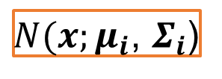
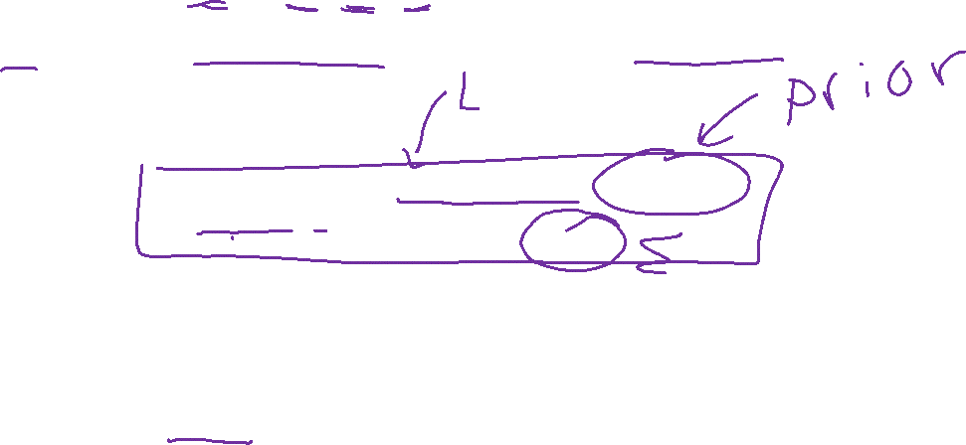
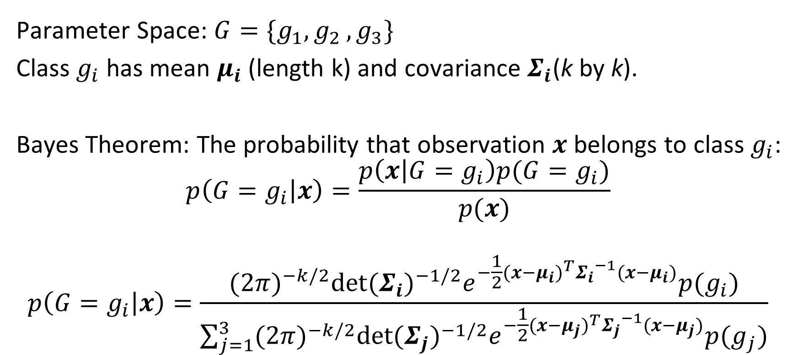
Bayesian Classification – Example w/ 3 Classes
Parameter Space: $G=\{g_{1}{,g}_{2},g_{3}\}$
Class $g_{i}$ has mean $μ_{i}$ (length k) and covariance $Σ_{i}$(k by k).
Bayes Theorem: The probability that observation $x$ belongs to class $g_{i}$:
$$p\left(G=g_{i} | x\right)=\frac{p\left(x | G=g_{i}\right)p(G=g_{i})}{p(x)}$$
$$p\left(G=g_{i} | x\right)=\frac{{(2π)}^{−k/2}{det⁡(Σ_{i})}^{−1/2}e^{−\frac{1}{2}{(x−μ_{i})}^{T}{Σ_{i}}^{−1}(x−μ_{i})}p(g_{i})}{\sum_{j=1}^{3}{{(2π)}^{−k/2}{det⁡(Σ_{j})}^{−1/2}e^{−\frac{1}{2}{(x−μ_{j})}^{T}{Σ_{j}}^{−1}(x−μ_{j})}p(g_{j})}}$$
$N(x;μ_{i}$, $Σ_{i}$)

Slide 30
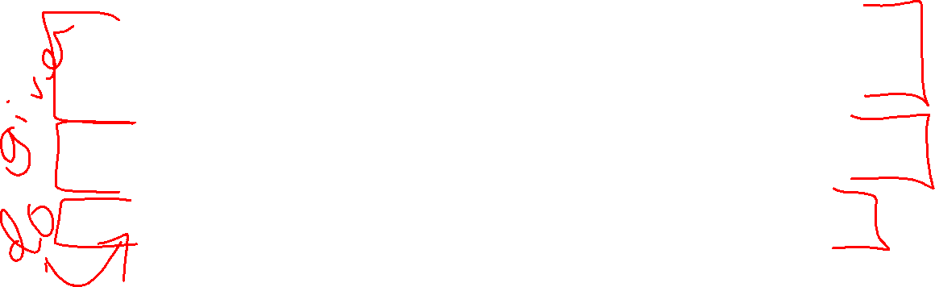
Bayesian Classification
Assume a distribution type for each class (typically, Gaussian either assuming all classes have the same covariance as in LDA or each with its own covariance as in QDA).
Compute the distribution for the likelihoods from the class training data.
Treat the class assignment as the parameter in Bayes Theorem.

Slide 31
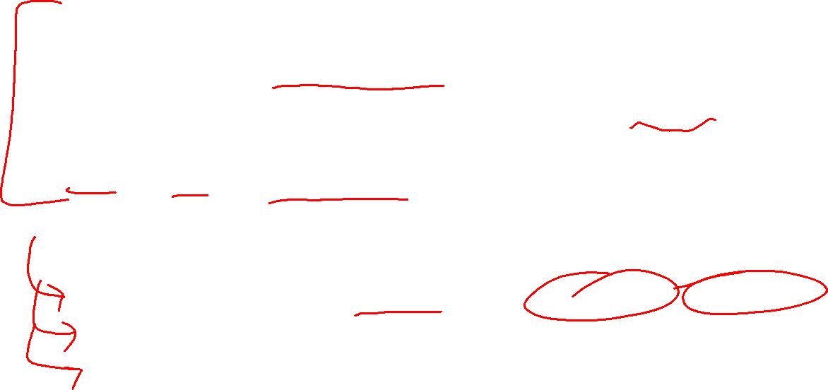
Topics:
Bayesian Framework for Linear Regression.
Regularization and ridge regression.
Bayesian Framework for classification assuming Gaussian distributions.
LDA and QDA with probabilities for classification and use of priors.
General Principles:
Bayesian methods provide probabilities for parameters & predictions.
Priors act as buffer against overtraining in Bayesian Regression.
As data is larger, priors become less significant/impactful/important.
Chapter 1

